Slide 1
Data-Driven Optimal Targeting Control of Chaotic Dynamical Systems
MAE 546 Optimal Control and Estimation
Samuel Otto

Slide 2
Chaotic Dynamical Systems
Found throughout nature, science, and engineering
Biology: Atrial fibrillation and epilepsy
Lightly damped nonlinear structural vibrations
Multi-body orbits perhaps encountered in asteroid mining
Turbulence, passive and active flow control devices
Chaotic systems are characterized by
Sensitivity to initial conditions
Mixing of trajectories in phase space
Behavior can appear random or exhibit intermittent quasi-periodicity
Technically: presence of a chaotic attractor with
No stable embedded orbits
Topological transitivity (mixing) ➔ ergodic

Slide 3
Controlling Chaos
Ott, Grebogi, and Yorke (OGY) seminal 1990 paper
Unstable periodic orbits embedded in the chaotic attractor can be stabilized with arbitrarily small control
Simply wait until trajectory enters sufficiently small neighborhood of desired orbit and activate stabilizing control system.
Oftentimes, chaos is undesirable, but control over the system is limited
Low-power device to stabilize atrial fibrillation
Low thrust control of chaotic asteroid orbit for mining
Chaos may actually be desirable if it can be controlled
Enables diverse behavior of the system
Low power covert communication

Slide 4
Targeting Control
Problem: We may have to wait an extremely long time before a chaotic trajectory enters a sufficiently small neighborhood of the desired orbit
Solution: (Targeting) use small perturbations to guide trajectories toward the desired orbit -- reducing time to stabilize it
Two methods considered here:
Neighboring optimal control near a nominal targeting path or tree leading to the desired orbit
Reinforcement learning to construct optimal targeting controller over the entire attractor

Slide 5
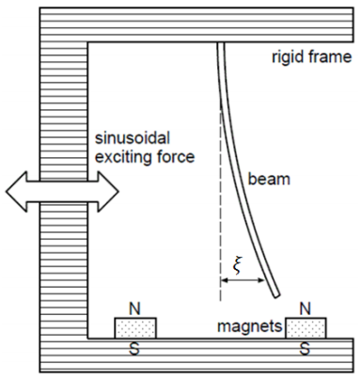
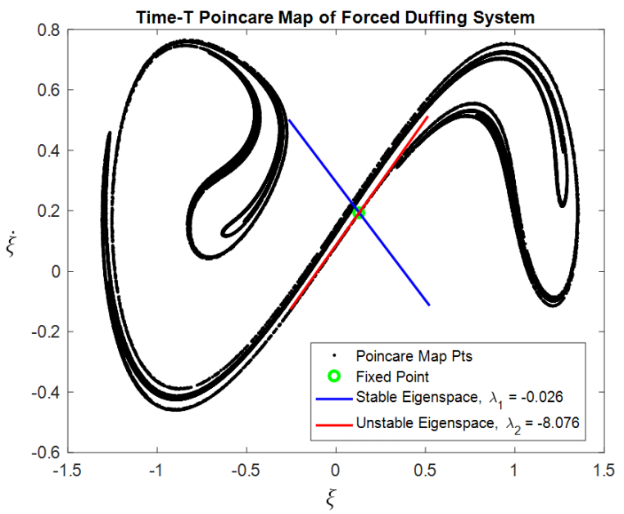
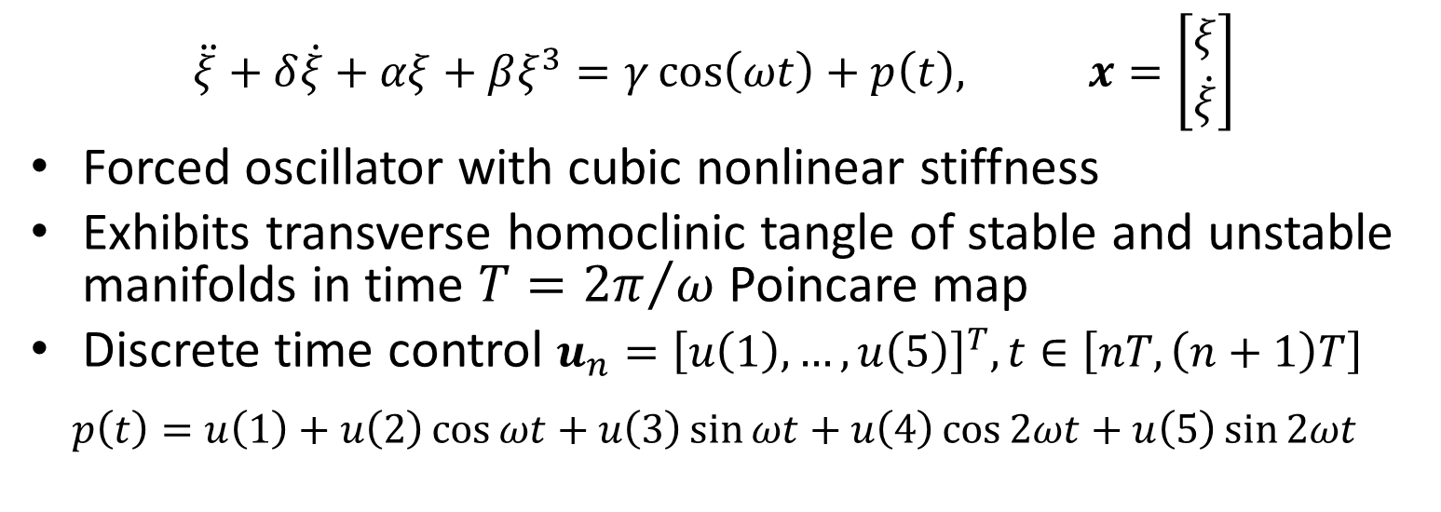
Example Problem: Forced Duffing Eqn.
$$\ddot{ξ}+δ\dot{ξ}+αξ+βξ^{3}=γ\cos\left(ωt\right)+p\left(t\right), x=\left[\begin{aligned}ξ \\ \dot{ξ}\end{aligned}\right]$$
Forced oscillator with cubic nonlinear stiffness
Exhibits transverse homoclinic tangle of stable and unstable manifolds in time $T={2π}/ω$ Poincare map
Discrete time control $u_{n}={\left[u\left(1\right), …,u\left(5\right)\right]}^{T}, t∈\left[nT,\left(n+1\right)T\right]$
$$p\left(t\right)=u\left(1\right)+u\left(2\right)\cos{ωt}+u\left(3\right)\sin{ωt}+u\left(4\right)\cos{2ωt}+u\left(5\right)\sin{2ωt}$$

Slide 6
Entirely Data-Driven Approach
Oftentimes, we do not have access to a model of the system’s dynamics which can be evaluated quickly enough to design control systems
We will infer accurate and efficient models of highly nonlinear chaotic dynamics using data alone.
All controllers designed using the learned dynamics model only!
Challenges with Chaotic Poincare maps
Highly nonlinear discrete time dynamics
Filamented, fractal structure of data manifolds in Poincare map
Global models with enough terms to capture nonlinearity are inefficient and tend to over-fit
Local nonlinear modeling is preferable
Each model has fewer terms ➔ efficient predictions
Arbitrarily complex dynamics are represented by adding more models, not by increasing model complexity.

Slide 7
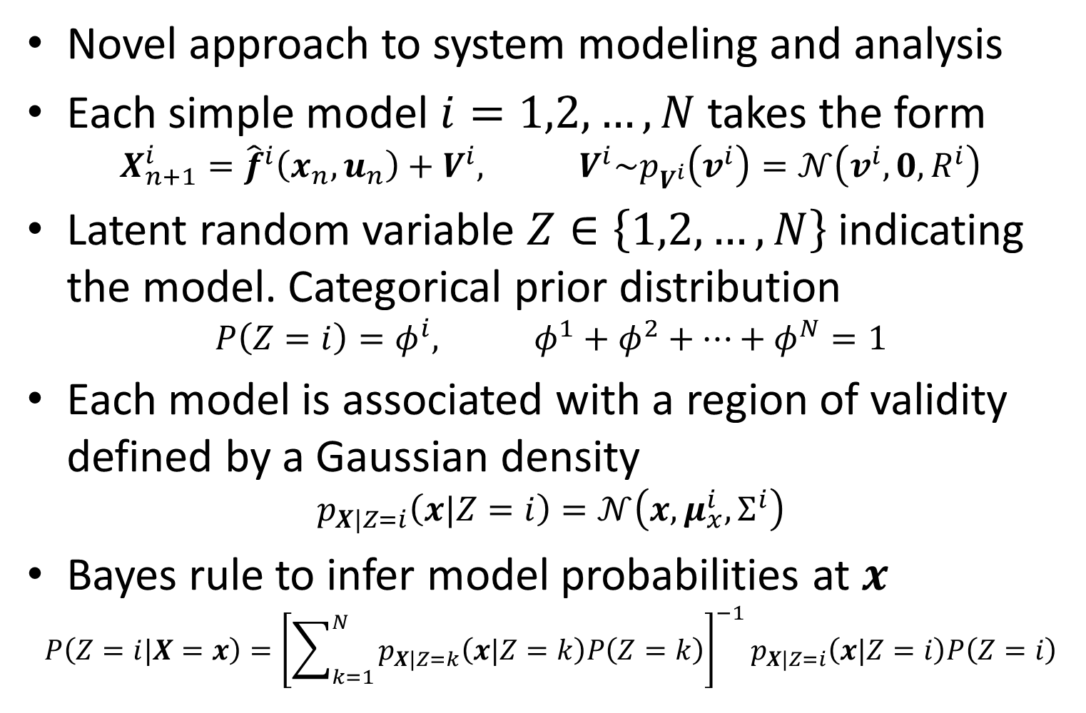
Local Nonlinear Models in Bayesian Framework
Novel approach to system modeling and analysis
Each simple model $i=1,2,…,N$ takes the form
$$X_{n+1}^{i}={\hat{f}}^{i}\left(x_{n},u_{n}\right)+V^{i}, V^{i}\sim p_{V^{i}}\left(v^{i}\right)=𝒩\left(v^{i},0,R^{i}\right)$$
Latent random variable $Z∈\left\{1,2,…,N\right\}$ indicating the model. Categorical prior distribution
$$P\left(Z=i\right)=φ^{i}, φ^{1}+φ^{2}+…+φ^{N}=1$$
Each model is associated with a region of validity defined by a Gaussian density
$$p_{X|Z=i}\left(x|Z=i\right)=𝒩\left(x,μ_{x}^{i},Σ^{i}\right)$$
Bayes rule to infer model probabilities at $x$
$$P\left(Z=i|X=x\right)={\left[\sum_{k=1}^{N}{p_{X|Z=k}\left(x|Z=k\right)P\left(Z=k\right)}\right]}^{−1}p_{X|Z=i}\left(x|Z=i\right)P\left(Z=i\right)$$

Slide 8
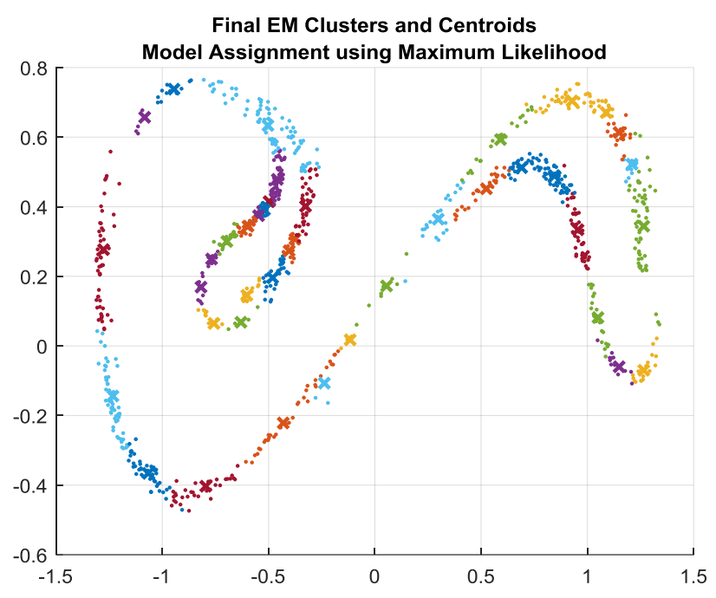
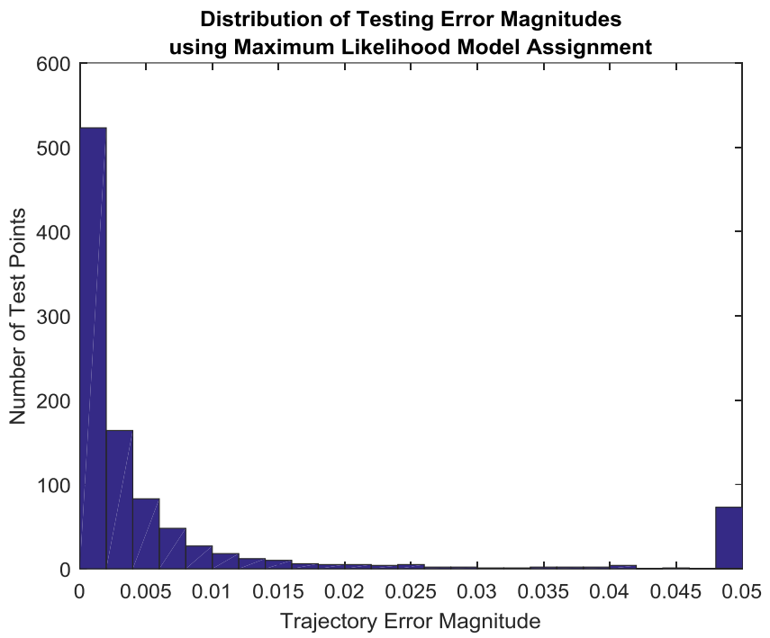
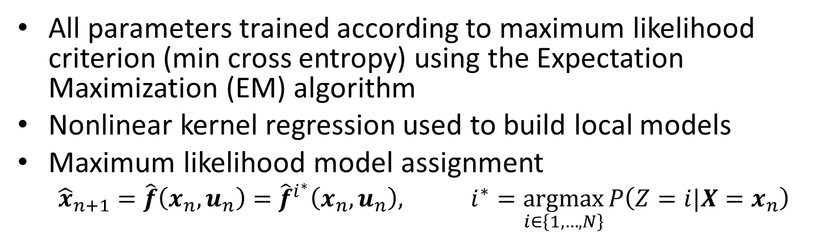
Local Nonlinear Models in Bayesian Framework
All parameters trained according to maximum likelihood criterion (min cross entropy) using the Expectation Maximization (EM) algorithm
Nonlinear kernel regression used to build local models
Maximum likelihood model assignment
$${\hat{x}}_{n+1}=\hat{f}\left(x_{n},u_{n}\right)={\hat{f}}^{i^{∗}}\left(x_{n},u_{n}\right), i^{∗}=\underset{i∈\left\{1,…,N\right\}}{argmax}{P\left(Z=i|X=x_{n}\right)}$$

Slide 9
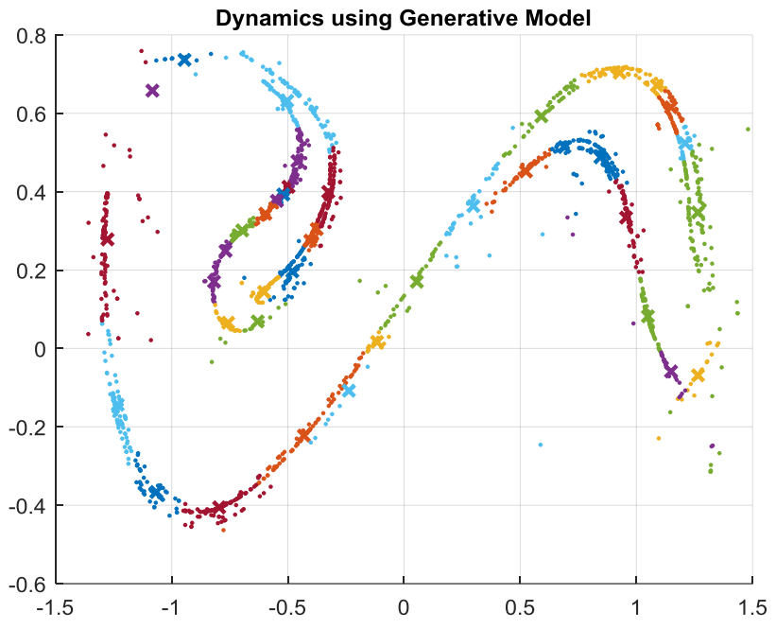
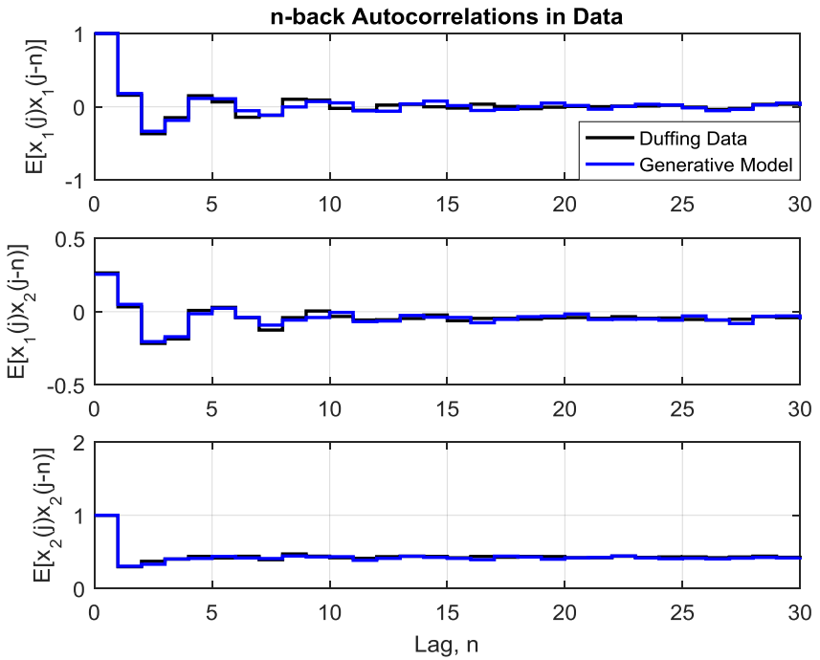
Performance as Generative Model
Does the learned model approximate the statistical behavior of the real system?
Look at (unforced) Poincare map generated by the model
Look at autocorrelations for real and modeled system

Slide 10
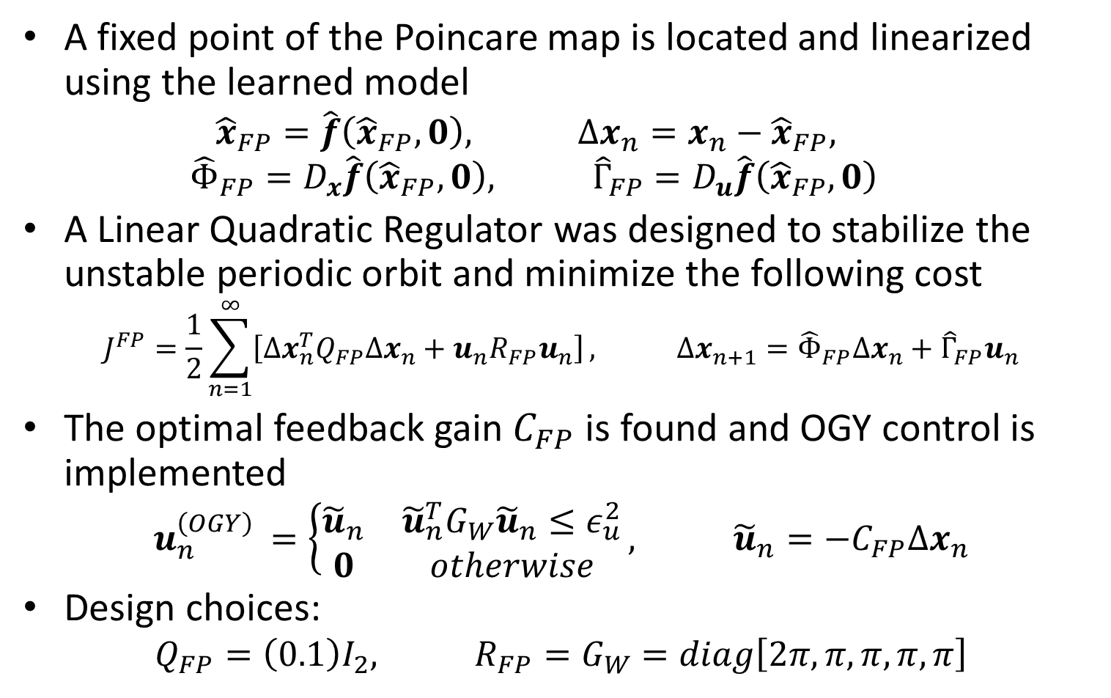
OGY Control using LQR
A fixed point of the Poincare map is located and linearized using the learned model
$${\hat{x}}_{FP}=\hat{f}\left({\hat{x}}_{FP},0\right), Δx_{n}=x_{n}−{\hat{x}}_{FP},$$
$${\hat{Φ}}_{FP}=D_{x}\hat{f}\left({\hat{x}}_{FP},0\right), {\hat{Γ}}_{FP}=D_{u}\hat{f}\left({\hat{x}}_{FP},0\right)$$
A Linear Quadratic Regulator was designed to stabilize the unstable periodic orbit and minimize the following cost
$$J^{FP}=\frac{1}{2}\sum_{n=1}^{∞}{\left[Δx_{n}^{T}Q_{FP}Δx_{n}+u_{n}R_{FP}u_{n}\right]}, Δx_{n+1}={\hat{Φ}}_{FP}Δx_{n}+{\hat{Γ}}_{FP}u_{n}$$
The optimal feedback gain $C_{FP}$ is found and OGY control is implemented
$$u_{n}^{\left(OGY\right) }=\left\{\begin{matrix}{\tilde{u}}_{n} & {\tilde{u}}_{n}^{T}G_{W}{\tilde{u}}_{n}≤ε_{u}^{2} \\ 0 & otherwise\end{matrix}\right., {\tilde{u}}_{n}=−C_{FP}Δx_{n}$$
Design choices:
$$Q_{FP}=\left(0.1\right)I_{2}, R_{FP}=G_{W}=diag\left[2π,π,π,π,π\right]$$

Slide 11
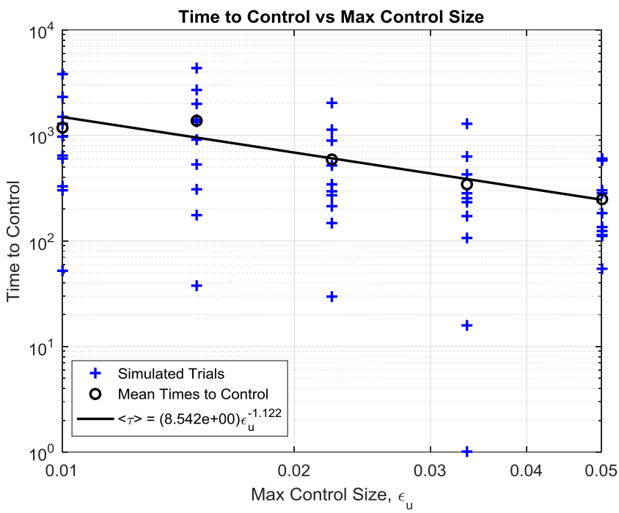
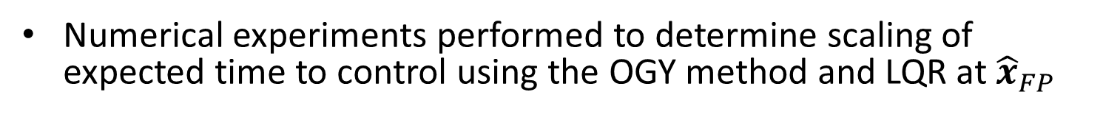
Time to Stabilize Scaling with Control Size
Numerical experiments performed to determine scaling of expected time to control using the OGY method and LQR at ${\hat{x}}_{FP}$

Slide 12
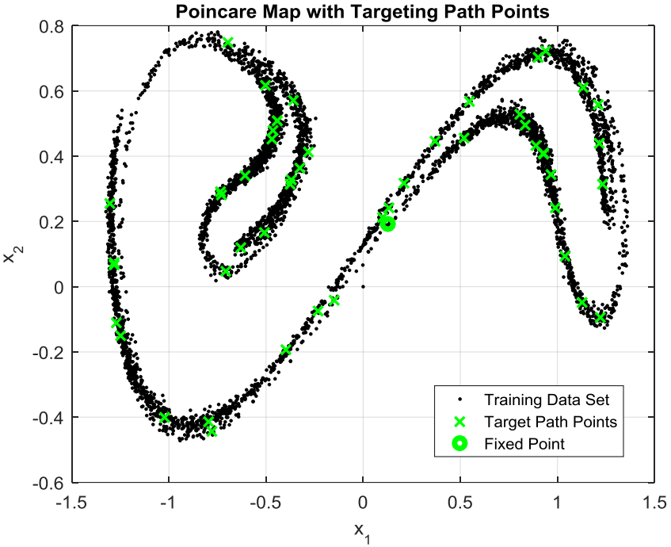
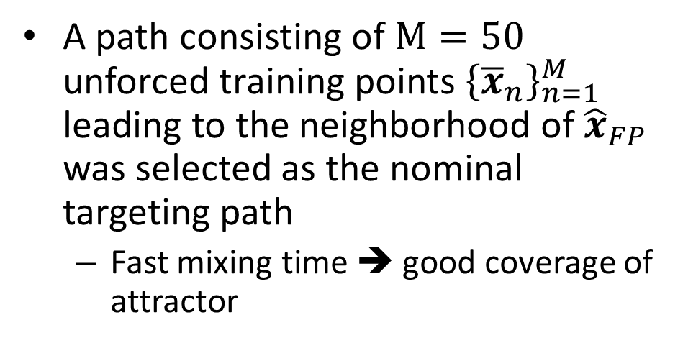
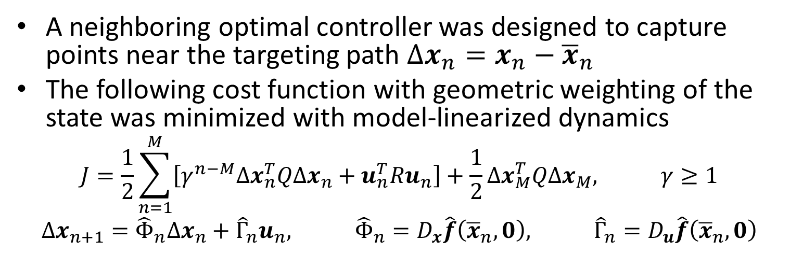
Neighboring Optimal Control using Targeting Path
A path consisting of $M=50$ unforced training points ${\left\{{\overline{x}}_{n}\right\}}_{n=1}^{M}$ leading to the neighborhood of ${\hat{x}}_{FP}$ was selected as the nominal targeting path
Fast mixing time ➔ good coverage of attractor
A neighboring optimal controller was designed to capture points near the targeting path $Δx_{n}=x_{n}−{\overline{x}}_{n}$
The following cost function with geometric weighting of the state was minimized with model-linearized dynamics
$$J=\frac{1}{2}\sum_{n=1}^{M}{\left[γ^{n−M}Δx_{n}^{T}QΔx_{n}+u_{n}^{T}Ru_{n}\right]}+\frac{1}{2}Δx_{M}^{T}QΔx_{M}, γ≥1$$
$$Δx_{n+1}={\hat{Φ}}_{n}Δx_{n}+{\hat{Γ}}_{n}u_{n}, {\hat{Φ}}_{n}=D_{x}\hat{f}\left({\overline{x}}_{n},0\right), {\hat{Γ}}_{n}=D_{u}\hat{f}\left({\overline{x}}_{n},0\right)$$

Slide 13
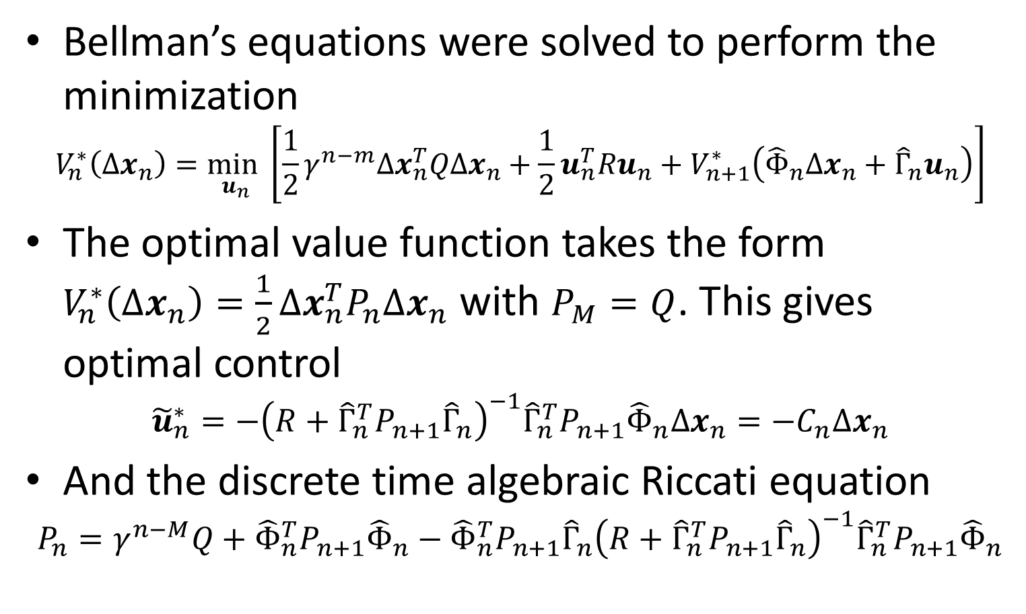
Neighboring Optimal Control using Targeting Path
Bellman’s equations were solved to perform the minimization
$$V_{n}^{∗}\left(Δx_{n}\right)=\min_{u_{n}}\left[\frac{1}{2}γ^{n−m}Δx_{n}^{T}QΔx_{n}+\frac{1}{2}u_{n}^{T}Ru_{n}+V_{n+1}^{∗}\left({\hat{Φ}}_{n}Δx_{n}+{\hat{Γ}}_{n}u_{n}\right)\right]$$
The optimal value function takes the form $V_{n}^{∗}\left(Δx_{n}\right)=\frac{1}{2}Δx_{n}^{T}P_{n}Δx_{n}$ with $P_{M}=Q$. This gives optimal control
$${\tilde{u}}_{n}^{∗}=−{\left(R+{\hat{Γ}}_{n}^{T}P_{n+1}{\hat{Γ}}_{n}\right)}^{−1}{\hat{Γ}}_{n}^{T}P_{n+1}{\hat{Φ}}_{n}Δx_{n}=−C_{n}Δx_{n}$$
And the discrete time algebraic Riccati equation
$$P_{n}=γ^{n−M}Q+{\hat{Φ}}_{n}^{T}P_{n+1}{\hat{Φ}}_{n}−{\hat{Φ}}_{n}^{T}P_{n+1}{\hat{Γ}}_{n}{\left(R+{\hat{Γ}}_{n}^{T}P_{n+1}{\hat{Γ}}_{n}\right)}^{−1}{\hat{Γ}}_{n}^{T}P_{n+1}{\hat{Φ}}_{n}$$

Slide 14
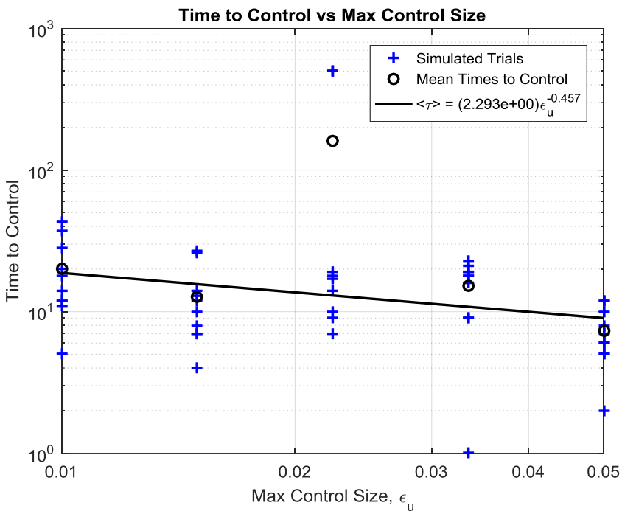
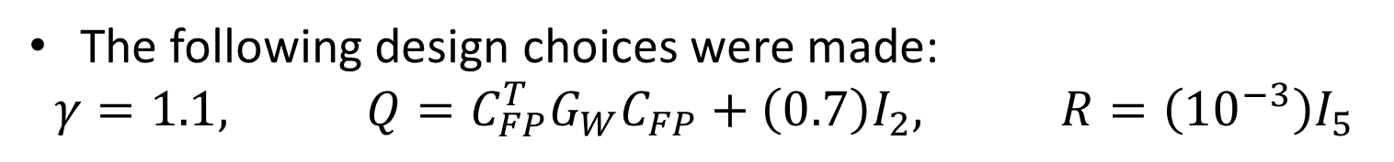
Time to Stabilize Scaling with Control Size
The following design choices were made:
$$γ=1.1, Q=C_{FP}^{T}G_{W}C_{FP}+\left(0.7\right)I_{2}, R=\left({10}^{−3}\right)I_{5}$$

Slide 15
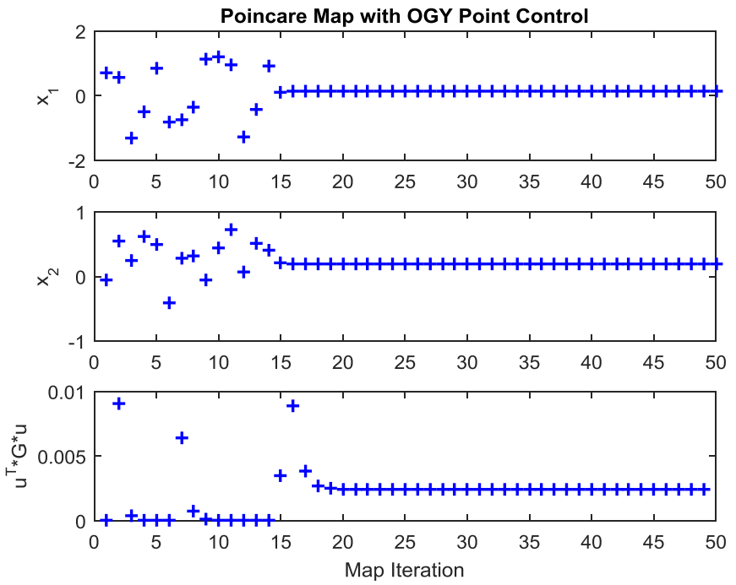
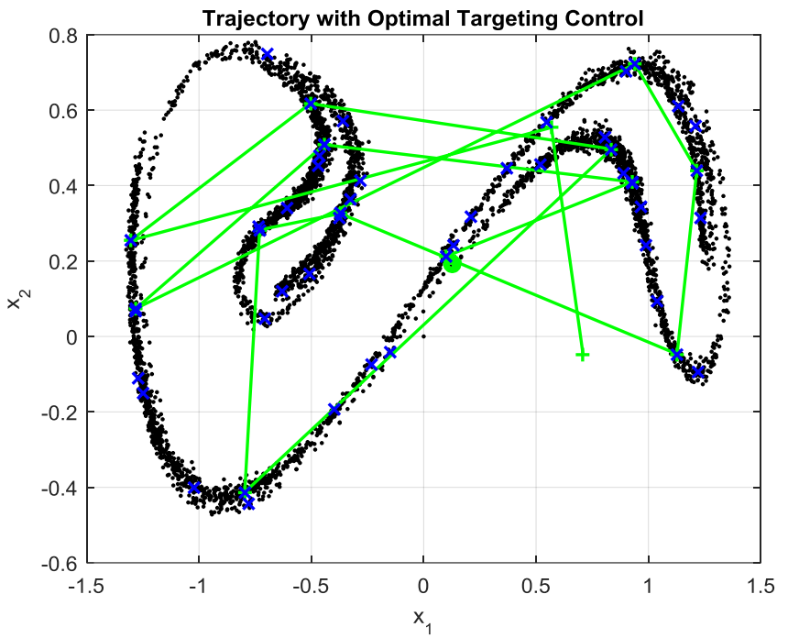
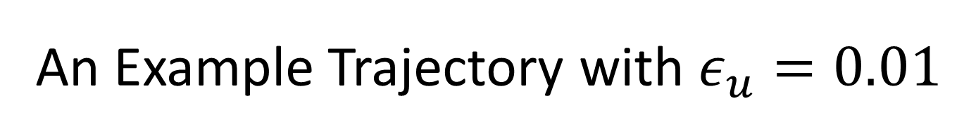

An Example Trajectory with $ε_{u}=0.01$
$$\sqrt{u^{T}Gu}$$

Slide 16
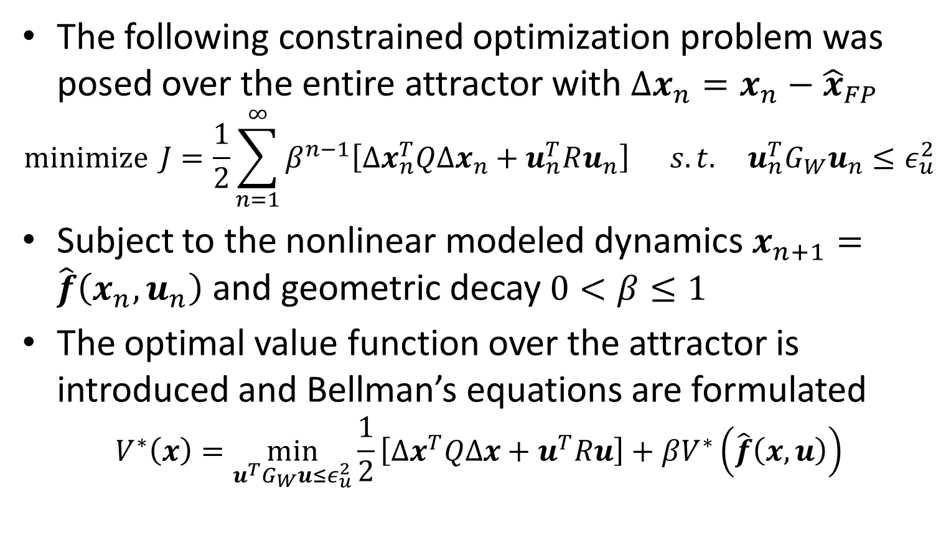
Optimal Control using Reinforcement Learning
The following constrained optimization problem was posed over the entire attractor with $Δx_{n}=x_{n}−{\hat{x}}_{FP}$
$$\operatorname{minimize}{J=\frac{1}{2}\sum_{n=1}^{∞}{β^{n−1}\left[Δx_{n}^{T}QΔx_{n}+u_{n}^{T}Ru_{n}\right]}} s.t. u_{n}^{T}G_{W}u_{n}≤ε_{u}^{2}$$
Subject to the nonlinear modeled dynamics $x_{n+1}=\hat{f}\left(x_{n},u_{n}\right)$ and geometric decay $0<β≤1$
The optimal value function over the attractor is introduced and Bellman’s equations are formulated
$$V^{∗}\left(x\right)=\min_{u^{T}G_{W}u≤ε_{u}^{2}}{\frac{1}{2}\left[Δx^{T}QΔx+u^{T}Ru\right]+βV^{∗}\left(\hat{f}\left(x,u\right)\right)}$$

Slide 17
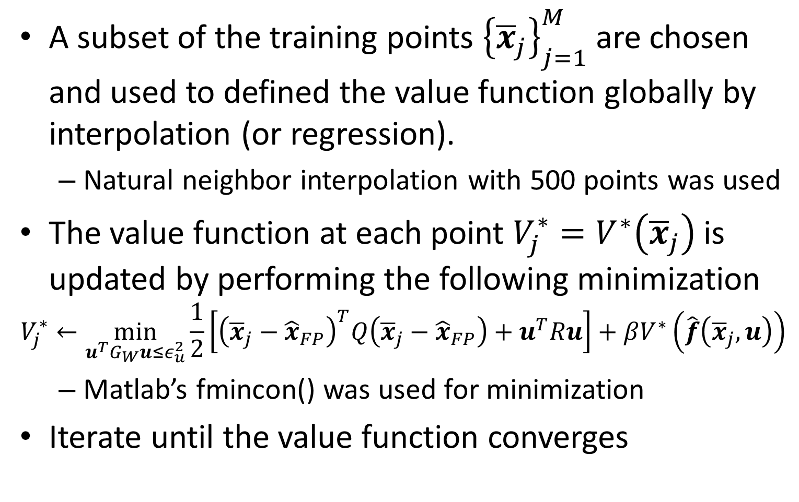
Fitted Value Iteration
A subset of the training points ${\left\{{\overline{x}}_{j}\right\}}_{j=1}^{M}$ are chosen and used to defined the value function globally by interpolation (or regression).
Natural neighbor interpolation with 500 points was used
The value function at each point $V_{j}^{∗}=V^{∗}\left({\overline{x}}_{j}\right)$ is updated by performing the following minimization
$$V_{j}^{∗}←\min_{u^{T}G_{W}u≤ε_{u}^{2}}{\frac{1}{2}\left[{\left({\overline{x}}_{j}−{\hat{x}}_{FP}\right)}^{T}Q\left({\overline{x}}_{j}−{\hat{x}}_{FP}\right)+u^{T}Ru\right]+βV^{∗}\left(\hat{f}\left({\overline{x}}_{j},u\right)\right)}$$
Matlab’s fmincon() was used for minimization
Iterate until the value function converges

Slide 18
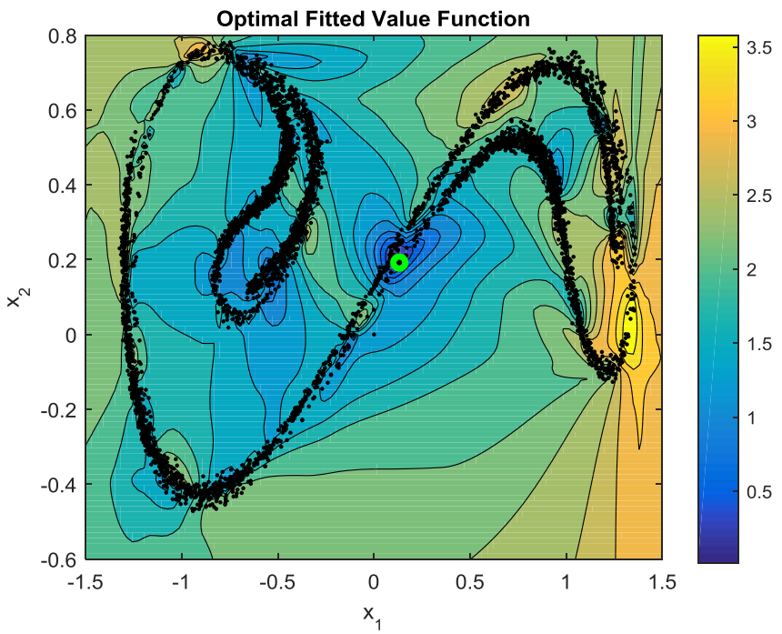
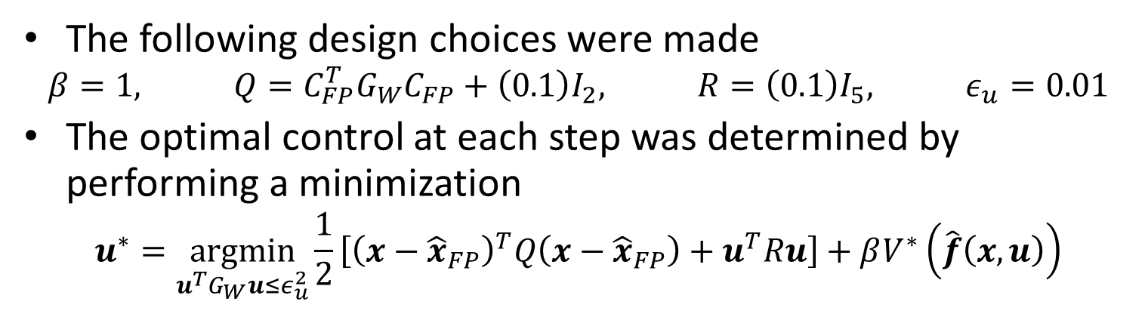
Optimal Value Function and Control
The following design choices were made
$$β=1, Q=C_{FP}^{T}G_{W}C_{FP}+\left(0.1\right)I_{2}, R=\left(0.1\right)I_{5}, ε_{u}=0.01$$
The optimal control at each step was determined by performing a minimization
$$u^{∗}=\underset{u^{T}G_{W}u≤ε_{u}^{2}}{argmin}{\frac{1}{2}\left[{\left(x−{\hat{x}}_{FP}\right)}^{T}Q\left(x−{\hat{x}}_{FP}\right)+u^{T}Ru\right]+βV^{∗}\left(\hat{f}\left(x,u\right)\right)}$$
(Note: It is possible to find the control at many points and build a model for the optimal control directly using a collection of nonlinear models and EM as with the dynamics)

Slide 19
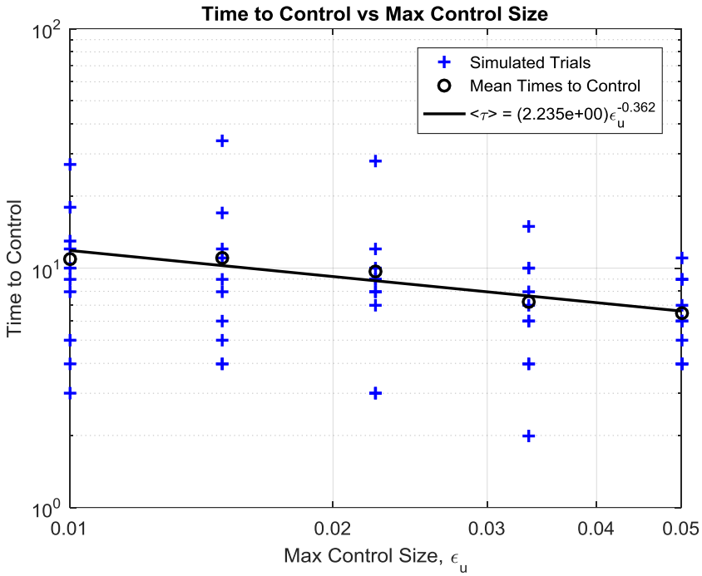
Time to Stabilize Scaling with Control Size

Slide 20
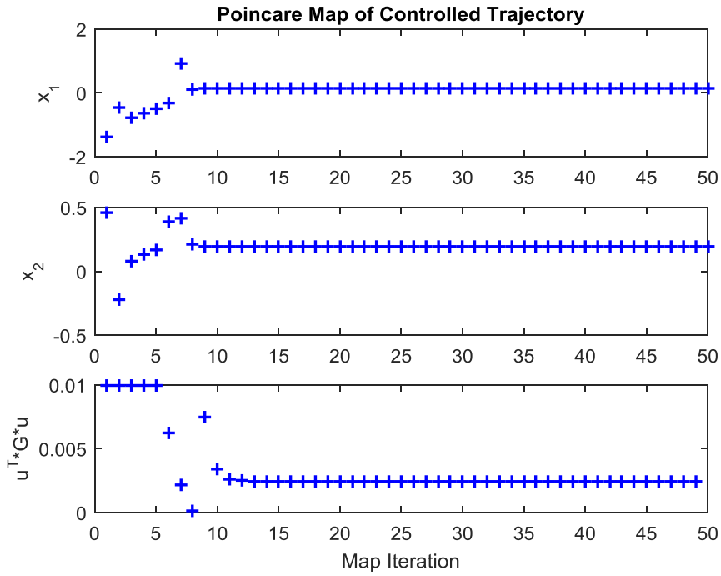
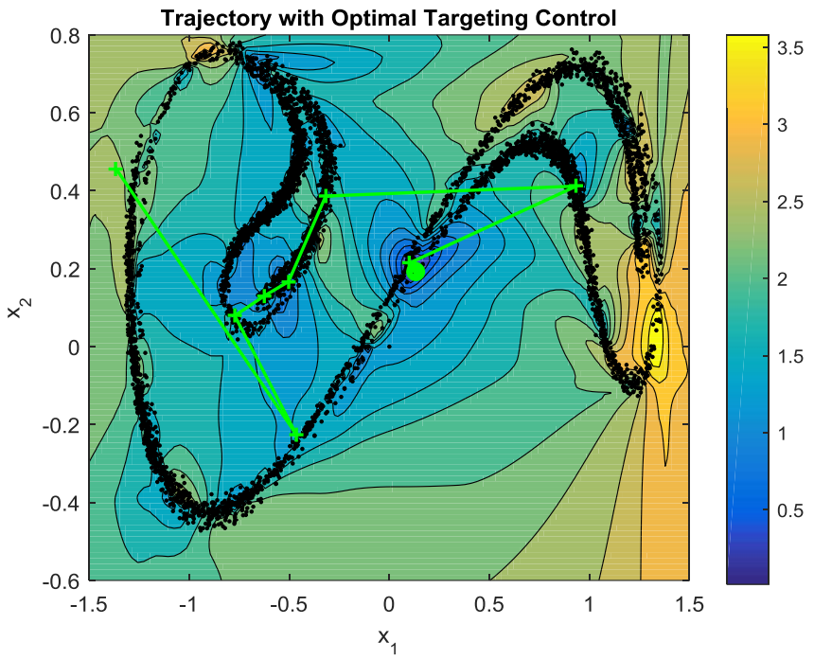
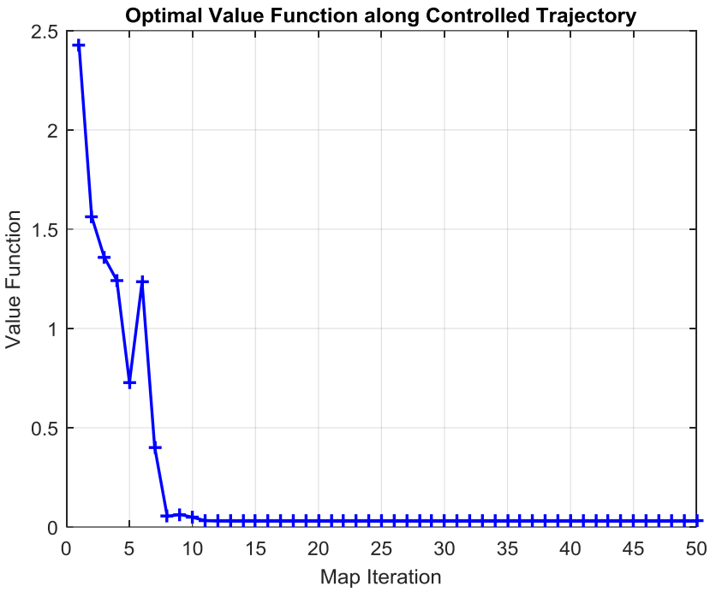
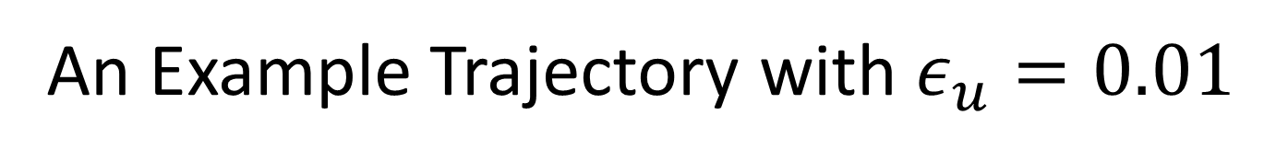
An Example Trajectory with $ε_{u}=0.01$
$$\sqrt{u^{T}Gu}$$

Slide 21
Conclusion
Novel data-driven modeling technique was introduced
Accurate and efficient representation of nonlinear dynamics enabled the design of optimal targeting controllers
Both targeting controllers show almost two orders of magnitude reduction in time to control over OGY only.
In its current implementation, the reinforcement learning approach is expensive
this cost can be reduced by learning a model for the optimal control
Future work includes using the local nonlinear modeling technique for state estimation
Multiple model estimation with extended or quasilinear Kalman filter

Slide 22
Questions?

